Slide 1

Towards Automatic Generation of Arabic Lexical Recognition Test
Mohammad Nassar
Jun 10, 2020

Slide 2
Outline
Introduction
Objectives
Research Questions
Research Methodology
Data Collections and Analysis – EDA
Experiments and Results
Conclusion

Slide 3
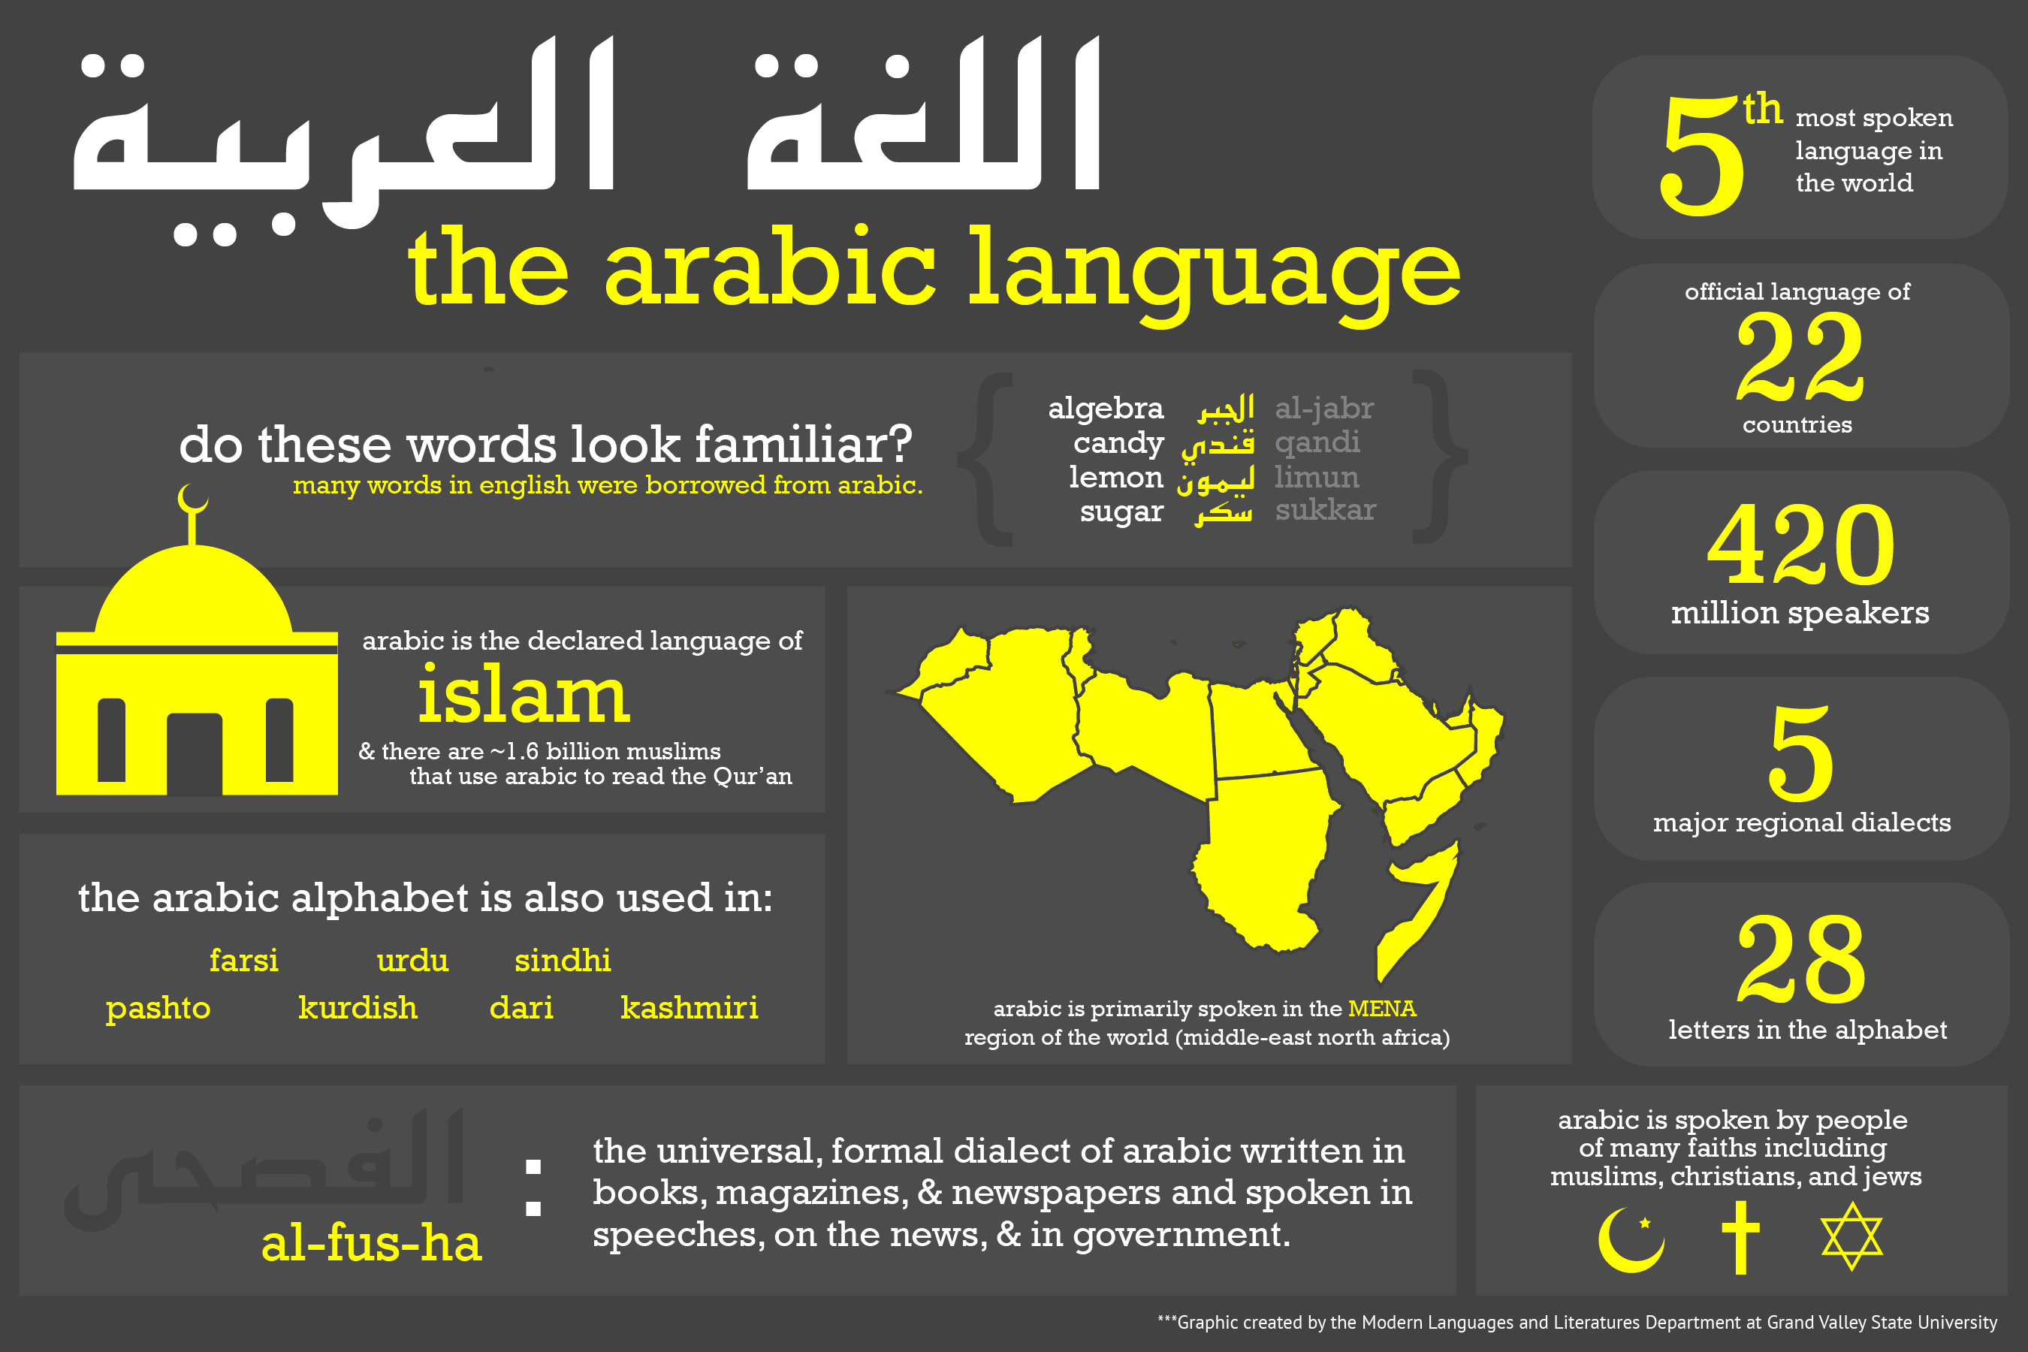
Outline
Notes:
https://www.gvsu.edu/mll/why-take-arabic-140.htm
https://www.uopeople.edu/blog/most-important-languages-to-learn/
Arabic started as a nomadic language, spoken between moving tribes. Today it is the official language of the Arab League, consisting of 22 countries such as Egypt, Jordan, Morocco, and the United Arab Emirates. These popular travel destinations make it worthwhile to learn Arabic. Not just that, it is the language of the entire Muslim civilization and all of its texts. With over 1.8 billion Muslims around the world, no wonder Arabic made the list.
https://www.marstranslation.com/blog/most-useful-languages-in-the-future
with 420 million speakers
100 million non-native speakers in the world today.
1.8 Muslims arounf the globle
https://www.worldometers.info/world-population/#religions
1,598,510,000 Muslims (23%), of which 87-90% are Sunnis, 10-13% Shia.

Slide 4
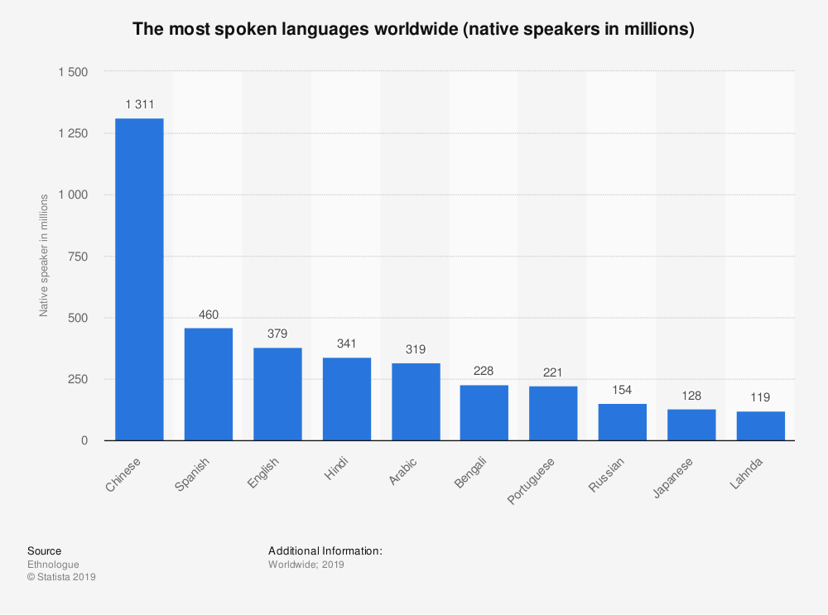
Introduction
help foreign learners of Arabic language and the interested parties to estimate learner proficiency level.
Arabic language considered one of the top seven languages that people communicate through around the world and it is one of the most growing languages.
learner cannot find an effective measure to indicate their level of recognition and knowledge in Arabic language.
Notes:
https://speakt.com/the-most-spoken-languages-in-the-world/
The language has over 400 million speakers with more than 130 million being nonnative speakers.

Slide 5
Introduction .. cont.
LRT applications characteristics
Quick Exam 7-10 min.
Could have different versions base on level, dialect, formal or un-formal languages.
Fit to beginners non native learners.
Provide key performance indicator of Arabic level.

Slide 6
Objectives
Enrich Arabic research content.
Facilitate measure of proficiency of Arabic.
Adapt LRT on Arabic languages.
Use Arabic Standard Model Languages.
Compare LRT results with actual student evaluation.
Evaluate new system accuracy.
Share potentials of Arabic LRT exam to be a real product.
Suggest future work enhancement.

Slide 7
Research Questions
Investigate adopting algorithm applied on English, German could be inherited and applied to Arabic language
Effect of Arabic languages special characteristics “Tanuin/Tashkeel” that make diacritization of the word; this attribute is only stick to Arabic language.
Create algorithmic design to generate good Arabic non-words that will be input to Arabic LRT.

Slide 8
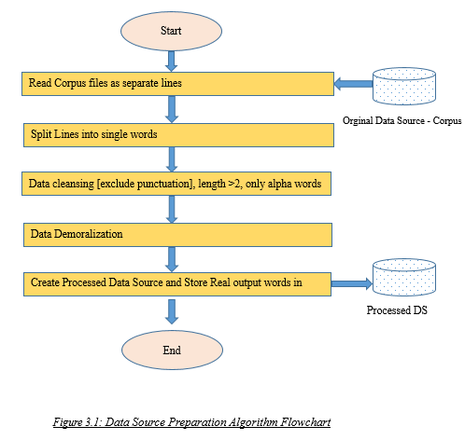
Research Methodology

Slide 9
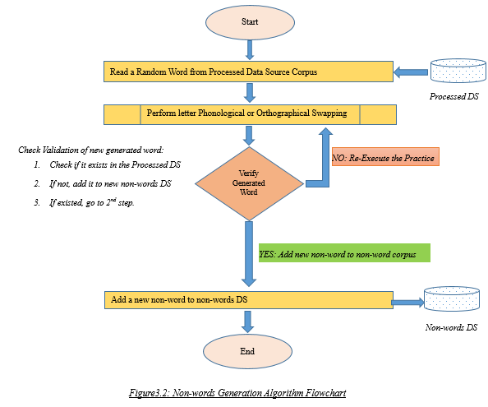
Detailed Architecture Non-words Generations

Slide 10
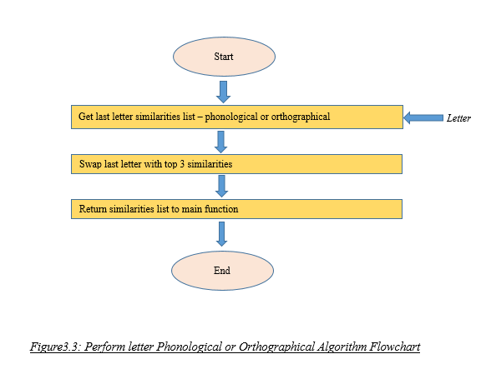
Detailed Architecture Non-words Generations

Slide 11
Detailed Architecture Non-words Generations
Similarities Letters |  | Similarities Type
ح،ج،خ |  | Orthographic
ب،ت،ث |  | Orthographic
س،ص،ش |  | Orthographic
ذ،د |  | Orthographic
ض،ذ،ظ،ض |  | Orthographic
ق،ك،ف |  | Orthographic
ع،غ |  | Orthographic
غ,ع,ح,خ, ه,ء | مخارج الحلق | Phonological
ت،ث،ج،د،ذ،ر،ز،س،ش،ص،ض،ط،ظ،ق،ك،ل،ث،ي | مخارج اللسان | Phonological
ب،ف،م،و | مخارج الشفتان | Phonological
أ،و،ي | مخارج الجوف | Phonological

Slide 12

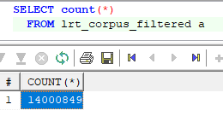
Data Collections and Analysis – EDA
Id | Description | File Name
1 | Non-Diacritized Corpus | aljazeera.txt
2 | Non-Diacritized Corpus | kacst.txt
3 | Non-Diacritized Corpus | khaleej.txt
4 | Non-Diacritized Corpus | watan.txt
5 | Non-Diacritized Corpus | 11books.txt
6 | Non-Diacritized Corpus | aljazeera100.txt
7 | Non-Diacritized Corpus | kacst100.txt
8 | Non-Diacritized Corpus | khaleej100.txt
9 | Non-Diacritized Corpus | msa.txt
10 | Non-Diacritized Corpus | quran.txt
11 | Non-Diacritized Corpus | rdi.txt
12 | Non-Diacritized Corpus | tweets.txt
13 | Non-Diacritized Corpus | tweets-ann.txt
14 | Non-Diacritized Corpus | watan100.txt
15 | Non-Diacritized Corpus | tweets-sharp.txt
16 | Non-Diacritized Corpus | WikiNewsTruth.txt
17 | Diacritized Corpus | watan-diac.txt

Slide 13
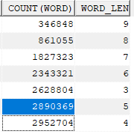
Exploratory Data Analysis
select count (word), word_len from (
SELECT word_seq, word, LENGTH(word) word_len
FROM lrt_corpus_filtered
)
where word_len (9,8,…,3)
group by word_len

Slide 14
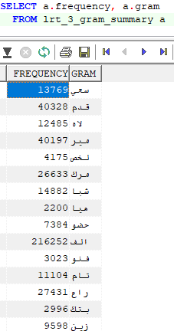
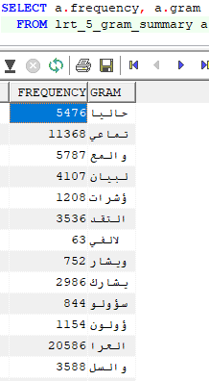
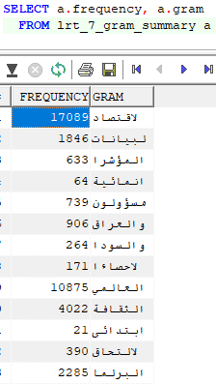
Exploratory Data Analysis

Slide 15
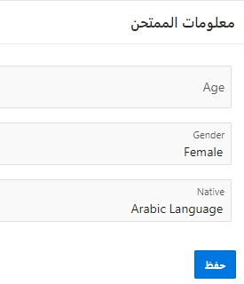
Experiments & Results
Prove of concept od delivered throughput were tested by:
Geneating random LRT exams.
Mixing real words & non-words (10*20) web application using Oracle APEX frameworks.
Generate random Arabic LRT exam for each exam session.
Target students are 7-9 years
Comparing student LRT rates with actual rate of student as being evaluated in the real course.

Slide 16
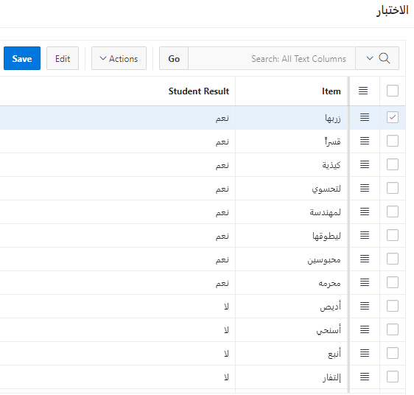
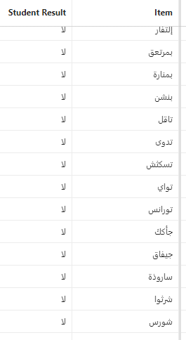
Experiments & Results

Slide 17
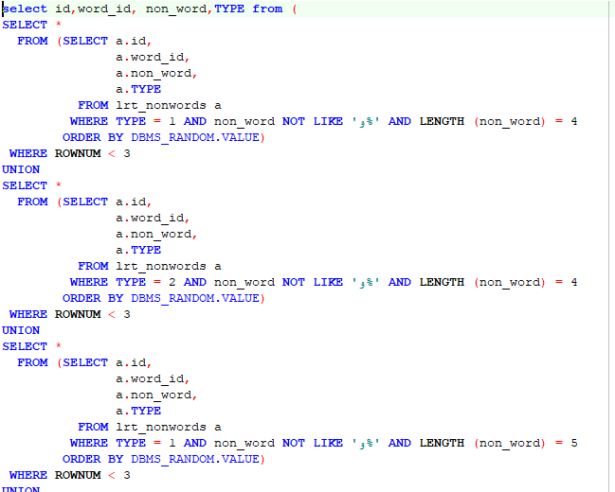
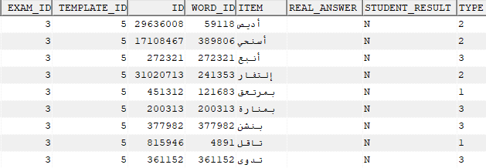
Experiments & Results

Slide 18
Conclusion … Strengths
Short, simple
Enrich Arabic language research content
Availability, Accessibility
Scalable and extendable research, this stage is being performed over vocabulary size; next time will could be done over sentence size.
Easy to get product from this application/project.

Slide 19
Conclusion … Weaknesses
Lack of sources (Arabic MSA - Corpus).
Time consuming in generation and validation on generated non-words.
Lack of researches (Arabic LRT)
Arabic language words diversity and high, more than 12 million.
Tashkeel probabilities !!
Notes:
Lack of resources of large-scale research, available corpuses are limited and restricted to news agencies, other corpuses are paid services.
Time consuming in generation and validation on generated non-words.
No depth experience and relevant researches in this field
Arabic language words diversity and high probabilities of used words and unused words “just a few millions (if you disregard all words not currently in usage), 12 million (one restrict rule) 90 million words and 500 million words! All of these numbers are the results of linguistic queries conducted in the past. And the number varies depending on what you count as a word.”
https://www.quora.com/How-many-words-does-the-Arabic-language-have
This will consider strange generated non-words and unused words might increase difficulty to identify them from non-words as they unused nowadays.

Slide 20
Future Work
Arabic words diacritization effect.
Arabic dialects (Levant, Egyptians, Gulf, Moroccan)
Non-native students examiners.
LRT as API service to check words spelling and to distinguish real words from incorrect words.
Notes:
Actually, including Arabic words diacritization will enhance the exam and make generated words more robust as Arabic TASHKEEL make it very critical ambiguous words that ends with more confusion to guess if this a real word or not.
Besides diacritization, including Arabic dialects will enrich our source with daily used language, so examiner will be able to practice daily used word; this will make that exam more realistic.
In addition to aforementioned, practicing the generated exams with non-native students will enhance accuracy rate since native users find it easier to identify non-words.
Finally, generated non-words database could be used as an API service to check words spelling and to distinguish real words from incorrect words.

Slide 21


